Slide 1
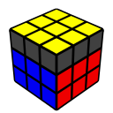
Improver Method – Pt. 3
Michael George
WCA ID: 2015GEOR02

Slide 2
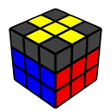

Orientation of the Last Layer (OLL)
“Beginner” method used 2 simple algorithms
6-move modified trigger F (U R U’ R’) F’ for edge orientation (EOLL)
8-move combination of triggers (R U2 R’ U2’) and (U R U’ R’) for corner orientation (OCLL)
“Improver” method will use 4 simple algorithms
6-move algorithms for edge orientation (EOLL) – F R U moves
7-move algorithms for corner orientation (Sune and Anti-Sune) – R U moves
The new algorithms will be easy to learn and incorporate into your solves
The beginner Anti-Sune (combination of triggers) will be shortened from 8 moves to 7 moves
The additional EOLL + OCLL algorithms will each be a simple “inverse”

Slide 3
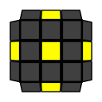
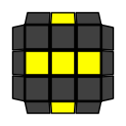
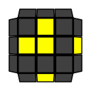
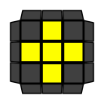
Edge Orientation of the Last Layer (EOLL)
There are 4 possible cases during EOLL including the “solved” case
The “adjacent edge flip” is the most common EOLL as it occurs in 4/8 solves (i.e. 50% of the time)
The other two cases take longer to solve if you only know the F (U R U’ R’) F’ algorithm
1/8
2/8
4/8
1/8

Slide 4
EOLL Algorithms
To change the orientation of edges you will use a mixture of F R U moves
The first EOLL algorithm that will be used is F (U R U’ R’) F’
Notice how it includes the U R U’ R’ trigger that is used during F2L
The F is referred to as a “setup” move and the F’ will undo the setup
The algorithm “flips” two adjacent LL edges (UF and UR) and has a side effect of “permuting” LL pieces
The second EOLL algorithm that will be used is F (R U R’ U’) F’
Notice how it includes the R U R’ U’ trigger that is used during F2L
The F is referred to as a “setup” move and the F’ will undo the setup
The algorithm “flips” two opposite LL edges (UF and UB) and has a side effect of “permuting” LL pieces
Note how the two algorithms are both an “inverse” of each other

Slide 5
Dot Case
The “Dot” case will still take the most effort to solve as it will require both algorithms
Approach: “Dot” -> “opposite edge flip” -> “solved”
Setup: Ensure the “opposite edge flip” is a horizontal line before executing the F (R U R’ U’) F’ algorithm
Algorithm: F (U R U’ R’) F’ U’ F (R U R’ U’) F’
e.g.
Dot
Opposite
Solved

Slide 6
EOLL Efficiency
“Beginner” – 1 algorithm – F (U R U’ R’) F’
Adjacent Flip / L / Clock 6 moves, 1 look
Opposite Flip / Lin e 12 moves, 2 looks
4-Flip / Dot 19 moves, 3 looks
“Weighted Average” 8.4 moves, 1.5 looks
“Improver” – 2 algorithms – F (U R U’ R’) F’ and F (R U R’ U’) F’
Adjacent Flip / L / Clock 6 moves, 1 look
Opposite Flip / Line 6 moves, 1 look
4-Flip / Dot 13 moves, 2 looks
“Weighted Average” 6.1 moves, 1.1 looks
Adjacent
Opposite
Dot
Solved

Slide 7
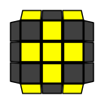
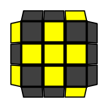
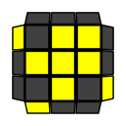
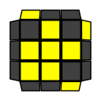
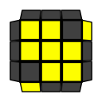
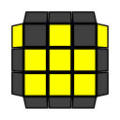
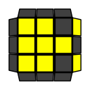
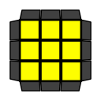
Orienting Corners of the Last Layer (OCLL)
There are 8 possible cases during OCLL including the “solved” case
2 twisted corners require the most effort if you only know the triggers (R U2 R’ U2’) and (U R U’ R’)
2/27
4/27
4/27
4/27
4/27
4/27
4/27
1/27

Slide 8
OCLL Algorithms
To affect the orientation of corners on the last layer you only need to use R U moves
The first OCLL algorithm is a combination of two triggers with a “cancellation” – R U2 R’ U’ R U’ R’
The R U2 R’ U2’ trigger extracts the front-right F2L pair
The U R U’ R’ trigger re-inserts the front-right F2L pair
The (R U2 R’ U2’) (U R U’ R’) cancels to R U2 R’ U’ R U’ R’ and is known as the “Anti-Sune” algorithm
The “Anti-Sune” algorithm will “twist” three LL corners counter-clockwise and will “permute” the LL edges
The second OCLL algorithm is a combination of two triggers with a “cancellation” – R U R’ U R U2’ R’
The R U R’ U’ trigger extracts the front-right F2L pair
The U2 R U2’ R’ trigger re-inserts the front-right F2L pair
The (R U R’ U’) (U2 R U2’ R’) cancels to R U R’ U R U2’ R’ and is known as the “Sune” algorithm
The “Sune” algorithm will “twist” three LL corners clockwise and will “permute” the LL edges
Note how the two algorithms are both an “inverse” of each other

Slide 9
3 Twisted Corners
There are 2 OCLL cases with 3 twisted corners
Approach: “Sune” or “Anti-Sune” -> “Solved”
Setup: Ensure the “oriented” corner is positioned correctly before executing the OCLL algorithm
Algorithm: R U2 R’ U’ R U’ R’ or R U R’ U R U2’ R’ – depending on the case
Anti-Sune
Solved
Sune
Solved

Slide 10

4 Twisted Corners
There are 2 OCLL cases with 4 twisted corners
Approach: “H / Double Sune” or “Pi / Bruno” -> “Anti-Sune” -> “Solved”
Setup: Ensure the back-right corner has its U-sticker on the back before executing the OCLL algorithm
Algorithm: R U2 R’ U’ R U’ R’ – twice, remembering to AUF prior to execution
or
H / Double Sune
Pi / Bruno
Anti-Sune
Solved

Slide 11
2 Twisted Corners
There are 3 OCLL cases with 2 twisted corners
Approach: “L / Bowtie” or “T / Chameleon” or “U / Headlights” -> “Sune” -> “Solved”
Setup: Ensure the back-right corner has its U-sticker on the right before executing the OCLL algorithm
Algorithm: R U2 R’ U’ R U’ R’ then R U R’ U R U2’ R’ – remembering to AUF prior to execution
or
or
L / Bowtie
T / Chameleon
U / Headlights
Sune
Solved

Slide 12
OCLL Efficiency
“Beginner” – 1 algorithm – (R U2 R’ U2’) (U R U’ R’)
4 twisted corners 16 or 17 moves, 2 looks
3 twisted corners 8 or 17 moves, 1 or 2 looks
2 twisted corners 26 moves, 3 looks
“Weighted Average” 19.0 moves, 2.3 looks
“Improver” – 2 algorithms – R U2 R’ U’ R U’ R’ and R U R’ U R U2’ R’
4 twisted corners 14 or 15 moves, 2 looks
3 twisted corners 7 moves, 1 look
2 twisted corners 15 moves, 2 looks
“Weighted Average” 12.0 moves, 1.7 looks
H / Double Sune
Pi / Bruno
Sune
Anti-Sune
L / Bowtie
T / Chameleon
U / Headlights
Solved

Slide 13
OLL Efficiency
“Beginner” – 2 algorithms – One EOLL algorithm + beginner Anti-Sune
“Worst Case” 45 moves, 6 looks
“Weighted Average” 27.3 moves, 3.8 looks
“Improver” – 4 algorithms – Two EOLL algorithms + Sune + Anti-Sune
“Worst Case” 28 moves, 4 looks
“Weighted Average” 18.1 moves, 2.8 looks
Comparison
“Worst Case” “Improver” method saves 17 moves, 2 looks –> 37.8% saving
“Weighted Average” “Improver” method saves 9.2 moves, 1 look –> 33.7% saving

Slide 14
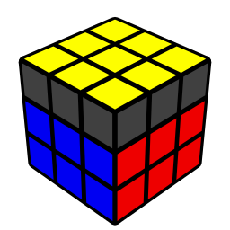

Nearly Done!

